Slide 1
Some Basic CSS
Tutorial #8

Slide 2
OBJECTIVE

Slide 3
Objective
This tutorial will give you a basic overview of how CSS works. You will be able to work with colors.

Slide 4
TEXTPLANATION

Slide 5
Textplanation
CSS is used to make your web pages sparkle. Almost any cool layout or graphic that you see on a web page is made using CSS. Once you understand the basic syntax, it should open the door to a lot of possibilities.

Slide 6
Textplanation
CSS code essentially reprograms how an HTML tag behaves. You specify the tag and then list the changes you want to make.

Slide 7
Textplanation
In this tutorial, we’re just dealing with color. It’s pretty simple, but very important.

Slide 8
Textplanation
There are 3 ways to indicate color in CSS.

Slide 9
Textplanation
RGB
The red, green, blue designation is the oldest. It works with numbers between 0 and 255, assigning a value to each color (red, blue, and green). This gives you access to a giant variety of colors and hues.

Slide 10
Textplanation
Hexadecimal
Base 16, or hex numbers are used in the same range as the base 10 numbers.
Hex digits range from 0 to F, with F being the number fifteen and “10” being the number sixteen. 00 is zero amd FF is 255, so 3 pairs of hex digits will give you an RGB value.

Slide 11
Textplanation
Mnemonics
HTML and CSS have many color mnemonics built in ranging from the simple colors like yellow and black to more unique colors like cornflowerblue.

Slide 12
CONSTRUCTION

Slide 13
Construction
Create a folder somewhere on your drive and label it Basic CSS.
Open up notepad++.
Save the empty file to your folder and name the file “index.html”.
All first pages on a website are called index.
As you go through the images of the construction, add to your code. You will see comments with explanations of what you are doing. Those comments will change with each slide. You should not type my comments into your code.

Slide 14

Construction

Slide 15
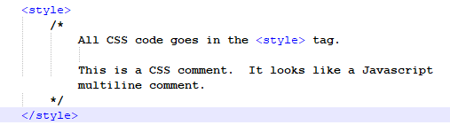
Construction

Slide 16
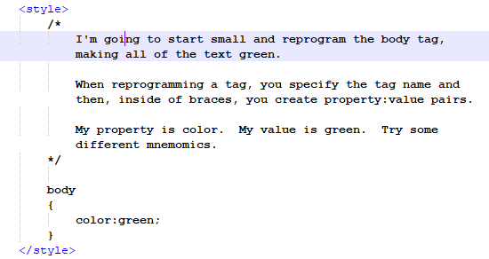
Construction

Slide 17
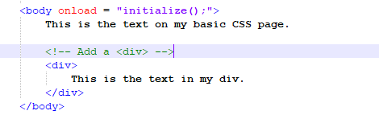
Construction

Slide 18
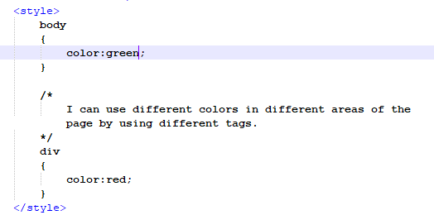
Construction

Slide 19
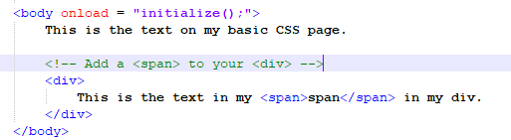
Construction

Slide 20
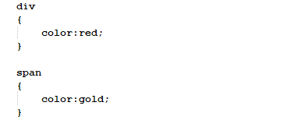
Construction

Slide 21
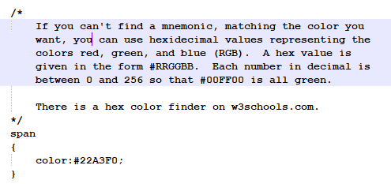
Construction

Slide 22
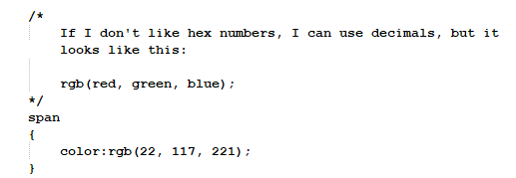
Construction

Slide 23
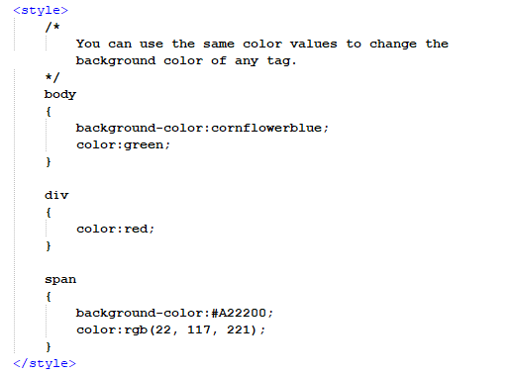
Construction

Slide 24
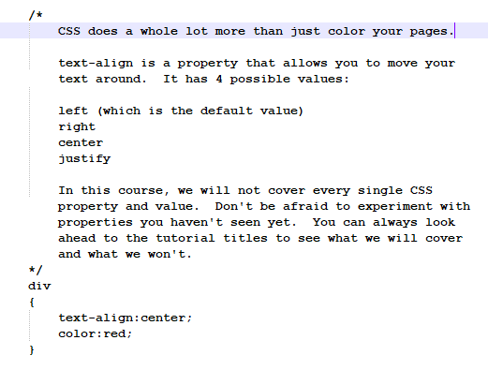
Construction

Slide 25
A DEEPER MEANING

Slide 26
A Deeper Meaning
Reprogramming an HTML tag goes a lot deeper than changing the color or the font. Because of the Document Object Model (DOM), CSS can manipulate the objects, changing all aspects of their display and moving them around.

Slide 27
A Deeper Meaning
CSS is also much more powerful than a simple reprogramming of a tag. Its properties are built into the objects meaning that you can manipulate them dynamically. That means you can change the color of something on the fly. You can also access objects through CSS. JQuery is a Javascript framework that uses CSS to access all of the HTML objects.

Slide 28
FAQ

Slide 29
FAQ
How come, when I center a <span>, it doesn’t do anything?
HTML displays tags in one of two ways. Inline or Block. A Block tag takes up a whole line and an inline tag takes up just the space of the content. Your <div> and <p> tags are block tags. Whether you have 1 word or 100 words, they take up whole lines and can be centered on those lines. Your <span> is inline. Its boundaries begin at the beginning of your first word and end at the end of your last. There’s no centering because there’s no additional room.

Slide 30
ACTIVITY

Slide 31
Activity Title
There is no activity for this tutorial. If you have completed the construction, you should be able to apply this concept to your Level 1 project and all your activities beyond.

